Slide 1

Redesigning the Organization with Information Systems
Chapter 13

Slide 2
Objectives
How could building a new system change the way an organization works?
How can a company make sure that the new information systems it builds fit its business plan?
What are the steps required to build a new information system?

Slide 3
Objectives
What alternative methods for building information systems are available?
Are there any techniques or system-building approaches to help us build e-commerce and e-business applications more rapidly?

Slide 4
Management Challenges
Major risks and uncertainties in systems development
Determining when new systems and business processes can have the greatest strategic impact

Slide 5
Systems as Planned Organizational Change
Linking Information Systems to the Business Plan
Information Systems Plan
Road map indicating direction of systems development: the rationale, the current situation, the management strategy, the implementation plan, and the budget

Slide 6
Systems as Planned Organizational Change
Establishing Organizational Information Requirements
Enterprise Analysis
(Business Systems Planning)
Analysis of organization-wide information requirements
Identifies key entities and attributes

Slide 7
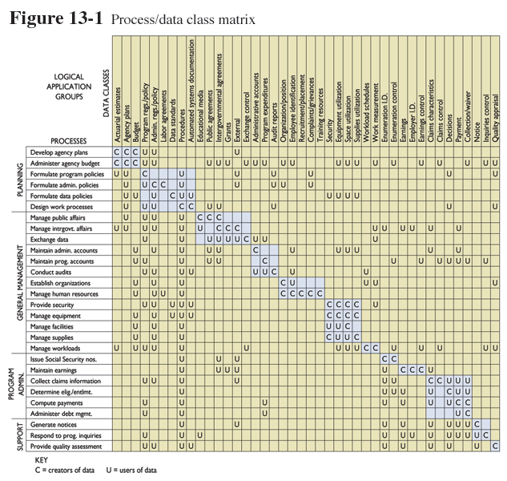
Systems as Planned Organizational Change
Process/data class matrix
Figure 13-1

Slide 8
Systems as Planned Organizational Change
Establishing Organizational Information Requirements
Strategic Analysis or
Critical Success Factors
Critical Success Factors (CSFs): A small number of easily identifiable operational goals shaped by industry, firm, manager, and broader environment. Used to determine information requirements of organization

Slide 9
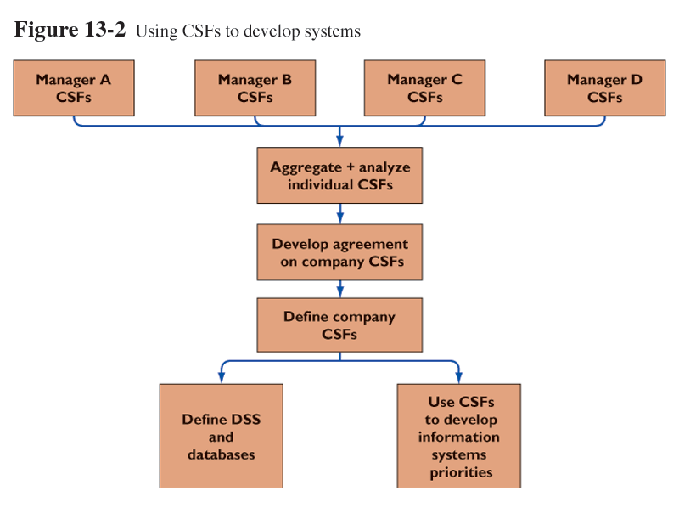
Systems as Planned Organizational Change
Using CSFs to develop systems
Figure 13-2

Slide 10
Systems as Planned Organizational Change
Systems Development and Organizational Change
The Spectrum of Organizational Change
Automation: Speeding up performance
Rationalization of procedures: Streamlining of operating procedures

Slide 11
Systems as Planned Organizational Change
Systems Development and Organizational Change
The Spectrum of Organizational Change
Business process reengineering: Radical design of business processes
Paradigm shift: Radical reconceptualization

Slide 12
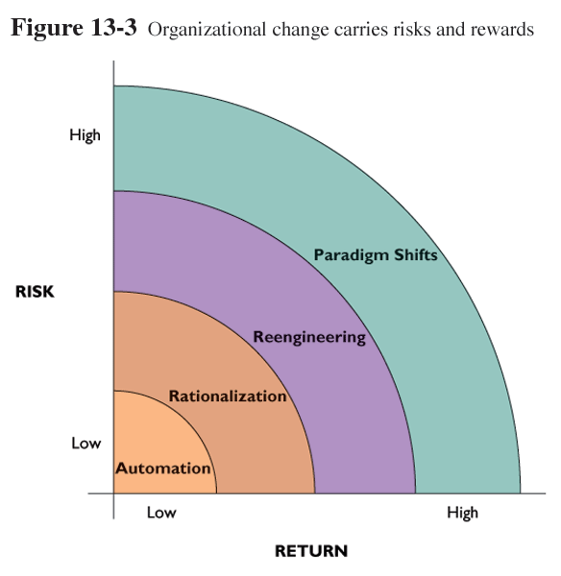
Systems as Planned Organizational Change
Organizational change carries risks and rewards
Figure 13-3

Slide 13
Business Process Reengineering and Process Improvement
Business Process Reengineering
Workflow Management
The process of streamlining business procedures so that documents can be moved easily and efficiently from one location to another

Slide 14
Business Process Reengineering and Process Improvement
Steps in Effective Reengineering
Senior management needs to develop broad strategic vision
Management must understand and measure performance of existing processes as baseline
Information technology should be allowed to influence process design from start
IT infrastructure should be able to support business process changes

Slide 15
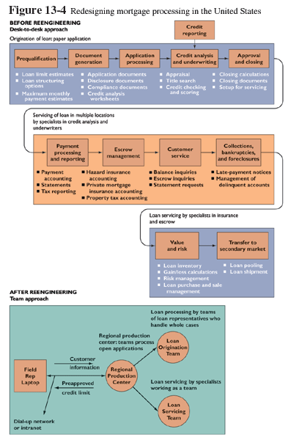
Business Process Reengineering and Process Improvement
Redesigning mortgage processing in the United States
Figure 13-4

Slide 16
Business Process Reengineering and Process Improvement
Process Improvement: Business Process Management,
Total Quality Management (TQM), and Six Sigma
Business Process Management (BPM): Enables organizations to manage incremental process changes required simultaneously in many areas of business. Provides a methodology for dealing with the organization’s need to optimize numerous internal business processes and processes shared with other companies

Slide 17
Business Process Reengineering and Process Improvement
Process Improvement: Business Process Management,
Total Quality Management (TQM), and Six Sigma
Total Quality Management (TQM): A concept that makes quality control a responsibility to be shared by all people in an organization
Six Sigma: A specific measure of quality representing 3.4 defects per million opportunities

Slide 18
Business Process Reengineering and Process Improvement
Process Improvement: Business Process Management,
Total Quality Management (TQM), and Six Sigma
How Information Systems Contribute
to Total Quality Management
Simplify product or production process
Enable benchmarking
Use customer demands as guide to improve products and services

Slide 19
Business Process Reengineering and Process Improvement
Process Improvement: Business Process Management,
Total Quality Management (TQM), and Six Sigma
How Information Systems Contribute
to Total Quality Management
Reduce cycle time
Improve the quality and precision of the design
Increase the precision of production

Slide 20
Overview of Systems Development
Overview
Systems Development: Activities that go into producing an information system solution to an organizational problem of opportunity
Systems Analysis: Analysis of a problem that the organization will try to resolve with an information system

Slide 21
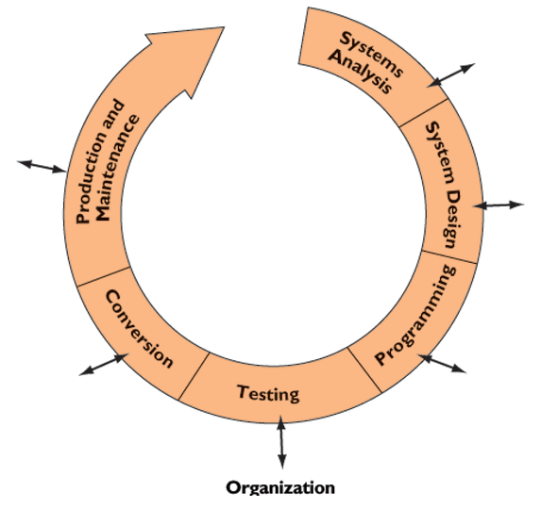
Overview of Systems Development
The systems development process
Figure 13-5

Slide 22
Overview of Systems Development
Systems Analysis
Feasibility Study: As part of the systems analysis process, the way to determine whether the solution is achievable, given the organization’s resources and constraints

Slide 23
Overview of Systems Development
Systems Analysis
Establishing Information Requirements
Stating information needs that new system must satisfy
Identifying who, when, where, and how components of information

Slide 24
Overview of Systems Development
Systems Design
Systems Design: Details how a system will meet information requirements as determined by the systems analysis

Slide 25
Overview of Systems Development
Completing the Systems Development Process
Programming: Process of translating system specifications prepared during the design stage into program code
Testing: Process that determines whether the system produces desired results under known conditions

Slide 26
Overview of Systems Development
Completing the Systems Development Process
Unit Testing: Process of testing each program separately
Systems Testing: Tests functioning of the information system as a whole
Acceptance Testing: Provides final certification that system is ready to be used in production setting
Test Plan: Prepared by development team. Includes preparations for the series of tests to be performed

Slide 27
Overview of Systems Development
Completing the Systems Development Process
Conversion
Conversion: Process of changing from the old system to the new system
Parallel Strategy: Conservative conversion approach where both the old system and the potential replacement are run together

Slide 28
Overview of Systems Development
Completing the Systems Development Process
Conversion
Direct Cutover: Risky conversion approach whereby the new system replaces the old system on an appointed day
Pilot Study: Strategy to introduce the new system to a limited area of the organization until it is proven to be fully functional

Slide 29
Overview of Systems Development
Completing the Systems Development Process
Conversion
Phased Approach: Introduces new system replacement in stages
Documentation: Descriptions of how an information system works from both a technical and end-user standpoint

Slide 30
Overview of Systems Development
Completing the Systems Development Process
Production and Maintenance
Production: Stage after new system is installed and the conversion is complete
Postimplementation Audit: Formal review process conducted after a system has been placed in production
Maintenance: Changes in hardware, software, documentation, or procedures of production system to correct errors

Slide 31
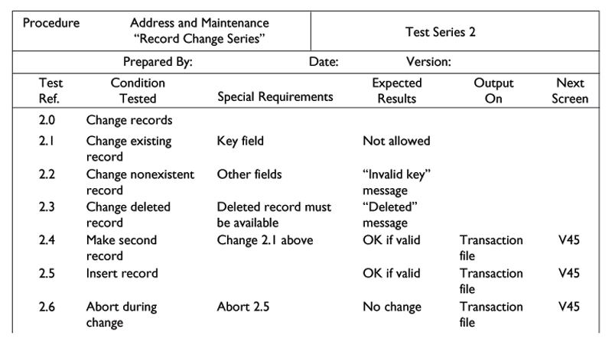
Overview of Systems Development
A sample test plan to test a record change
Figure 13-6

Slide 32
Alternative Systems-Building Approaches
Traditional Systems Lifecycle
Systems Lifecycle
Traditional methodology for developing information system that partitions the systems development process into formal stages that must be completed sequentially

Slide 33
Alternative Systems-Building Approaches
Prototyping
Prototyping: Process of building experimental system quickly and inexpensively for demonstration and evaluation so that users can better determine information requirements
Prototype: Preliminary working version of information system for demonstration and evaluation purposes

Slide 34
Alternative Systems-Building Approaches
Prototyping
Iterative: A process of repeating over and over again the steps to build system

Slide 35
Alternative Systems-Building Approaches
Prototyping
Steps in Prototyping
Identify the user’s basic requirements
Develop initial prototype
Use the prototype
Revising and enhancing the prototype

Slide 36
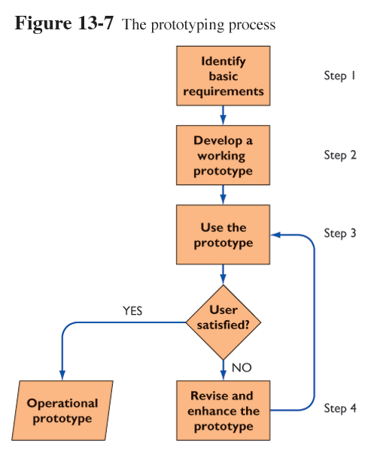
Alternative Systems-Building Approaches
The prototyping process
Figure 13-7

Slide 37
Alternative Systems-Building Approaches
Advantages and Disadvantages of Prototyping
Advantage
Useful in designing information system’s end-user interface
Disadvantage
Rapid prototyping can gloss over essential steps in systems development

Slide 38
Alternative Systems-Building Approaches
Application Software Packages
Application software packages: Set of prewritten, precoded application software programs commercially available for sale or lease
Customization: Modification of software package to meet organization’s unique requirements without destroying the software’s integrity

Slide 39
Alternative Systems-Building Approaches
Application Software Packages
Request for Proposal (RFP): Detailed list of questions submitted to vendors of software or other services to determine how well vendor’s product can meet organization’s specific requirements

Slide 40
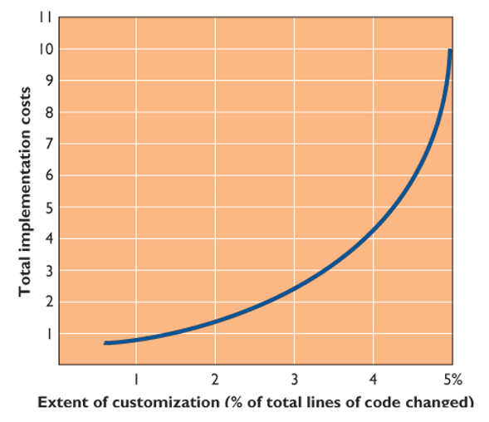
Alternative Systems-Building Approaches
The effects of customizing a software package on total implementation costs
Figure 13-8

Slide 41
Alternative Systems-Building Approaches
End-User Development
Development of information systems by end users with little or no formal assistance from technical specialists
Allows users to specify their own business needs

Slide 42
Alternative Systems-Building Approaches
End-User Development
Managing End-User Development
Information Center: A special facility within an organization that provides training and support for end-user computing

Slide 43
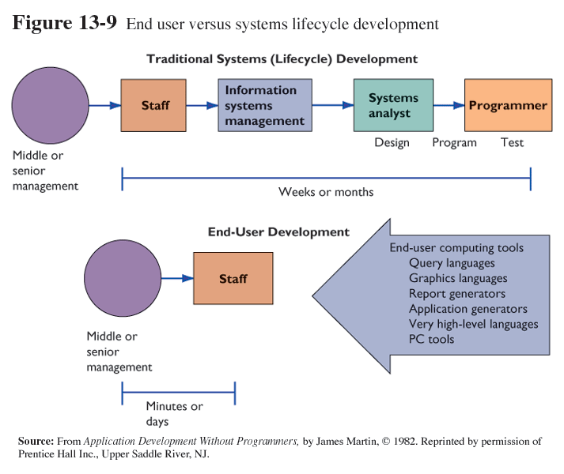
Alternative Systems-Building Approaches
End user versus systems lifecycle development
Figure 13-9

Slide 44
Alternative Systems-Building Approaches
Outsourcing
Practice of contracting computer center operations, telecommunications networks, or applications development to external vendors

Slide 45
Alternative Systems-Building Approaches
Window on Management
Outsourcing Moves into High Gear
What are the management benefits of outsourcing?
What management, organization, and technology issues must be addressed when deciding whether to outsource systems development?

Slide 46
Application Development for the Digital Firm
Object-Oriented Development and Component-Based Development
Object-Oriented Development: Approach to systems development that uses the object as the basic unit of systems analysis and design.
Component-Based Development: Building large software systems by combining pre-existing software components

Slide 47
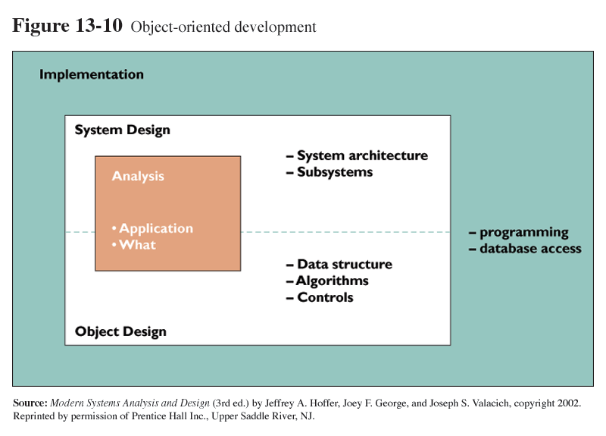
Application Development for the Digital Firm
Object-oriented development
Figure 13-10

Slide 48
Application Development for the Digital Firm
Rapid Application Development (RAD)
Process for developing systems in a short time period
Uses prototyping, fourth-generation tools, and close teamwork among users and systems specialists

Slide 49
Application Development for the Digital Firm
Joint Application Design (JAD)
Process to accelerate the generation of information requirements by having end users and information systems specialists work together in intensive design sessions

Slide 50
Application Development for the Digital Firm
Web Services and Service-Oriented Computing
Software components deliverable over Internet
Enable one application to communicate with another with no translation required
Standards and protocols: XML, SOAP, WSDL, UDDI

Slide 51
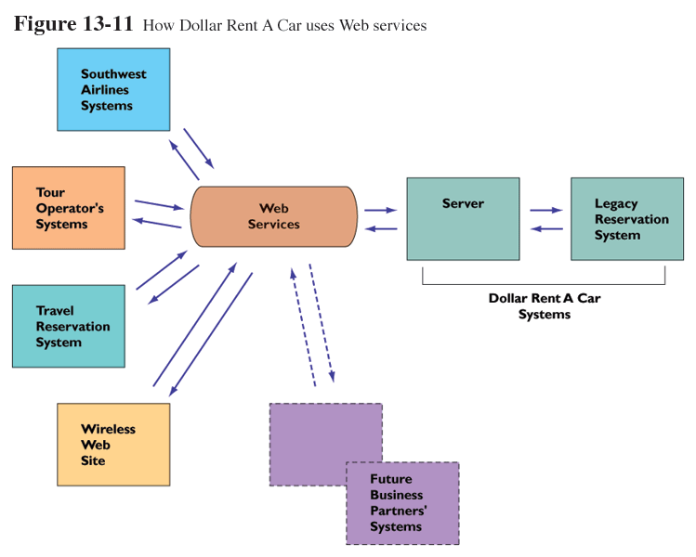
Application Development for the Digital Firm
How Dollar Rent A Car uses Web services
Figure 13-11

Slide 52
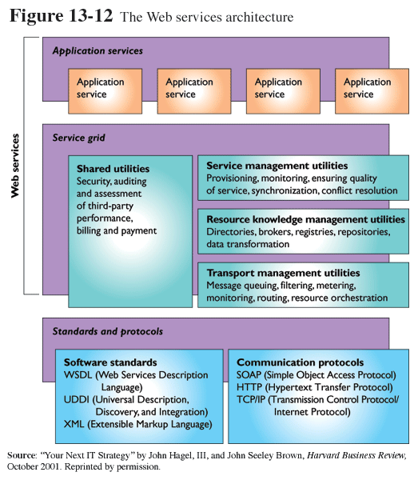
Application Development for the Digital Firm
The Web services architecture
Figure 13-12

Slide 53
Application Development for the Digital Firm
Window on Technology
Web Services at Work
What are the benefits of using Web services technology?
How can it provide value to firms?
What management, organization, and technology issues must be addressed when implementing Web services?

Slide 54
Chapter 13 Case Study
Celanese Recentralizes with a New Enterprise System
Analyze Celanese using the competitive forces and value chain models.
How important is Celanese’s centralized enterprise system to its business strategy? Why? What is its business value to the company?

Slide 55
Chapter 13 Case Study
Celanese Recentralizes with a New Enterprise System
What management, organization, and technology challenges did Celanese face as it tried to implement OneSAP? Which were the most difficult? Why?
How successful was Celanese in meeting these challenges? What problems did it solve? How? Which problems remained unsolved?

